Slide 1
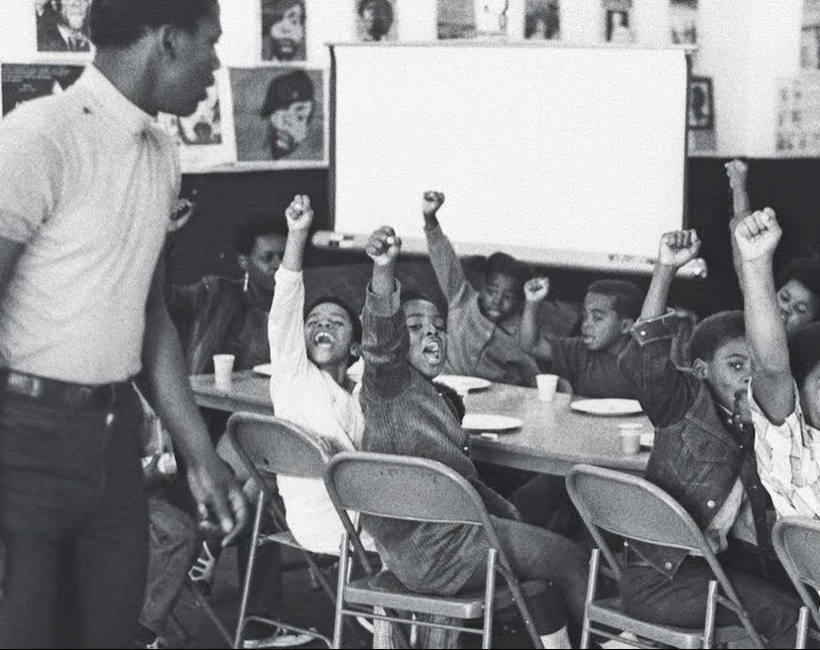
Building Organizational Power
Activity Slide Deck

Slide 2
Part 1: Power

Slide 3
What are some examples of movements with strong….
Narrative capacity?
Disruptive capacity?
Electoral or institutional capacity?

Slide 4
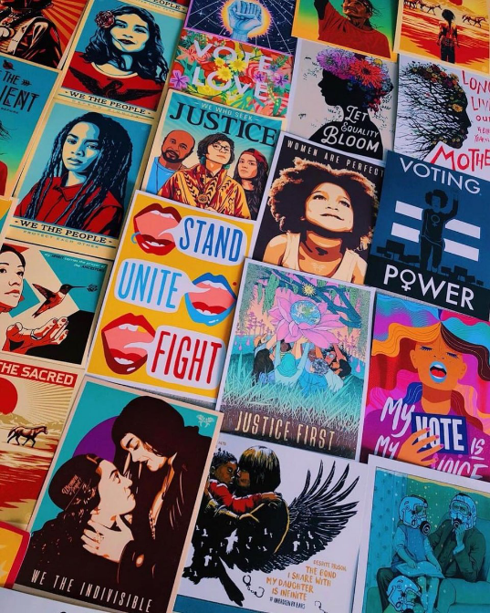
Discuss in pairs
What are some examples of successful social movements that inspire you in your climate work?
What were a few of the characteristics of those movements that you think contributed to their success?
Image: Amplifier Art

Slide 5
In small groups:
Think about your organization you:
How do they already embody these characteristics?
Independent
Committed
Flexible
What are the biggest areas for growth?
Notes:
Group 1:
Independent==being tied to funders makes it harder to be independent (hard for CRP)
Committed-people are very committed
Flexible--some people are really invested in the status quo, in timely fights they have to be flexible
Group 2:
Not doing great in these areas (chapters)
Hard to get people to be committed
Status quo--need to be flexible

Slide 6
Part 2: Organizational Power
How to set up your organization

Slide 7
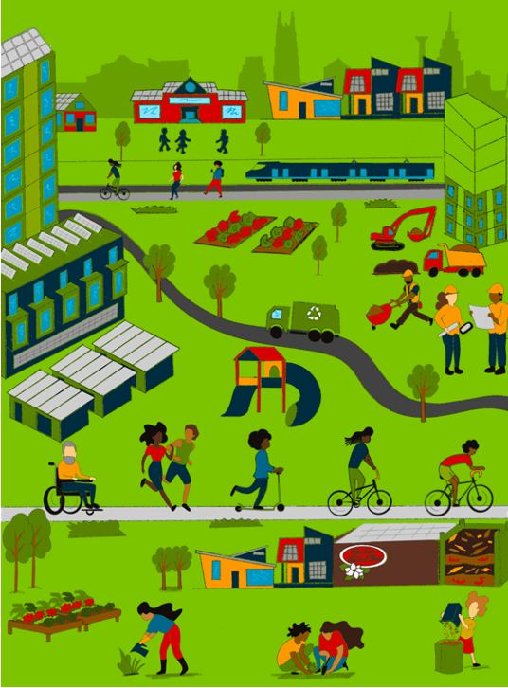
Tool: Vision: What is the world you are working to bring into being?
A shared sense of where we’re head in the long-terms helps us set the appropriate trajectory for our work
Campaigns with clear visions are more likely to be successful than those without them
Without alignment on vision, it’s easier to get distracted and/or pulled off course
Image: Riziki Omonde; Sierra Club Movement Manual, 2016; Moxley, 2003

Slide 8
🛠 Tool for you to use with vols: (Virtual) Gallery walk
Goal: Develop a shared vision statement for your Chapter’s work that is bold, inclusive, and serves as a “north star” to guide strategy and tactics
Take 7 minutes to reflect on your own:
Dream big!!
What will different about the day-to-day experience of folks across your community is our work is successful? What will it look like?
Capture your reflections on your slide (Right click on Slide X → Duplicate)
Get creative: Feel free to grab images from the interwebs and make a collage!
Then we’ll come back as a group
8 minutes for a “Gallery Walk” for everyone to scroll through other folks’ slides
13 minutes to tease out key themes across everyone’s vision

Slide 9
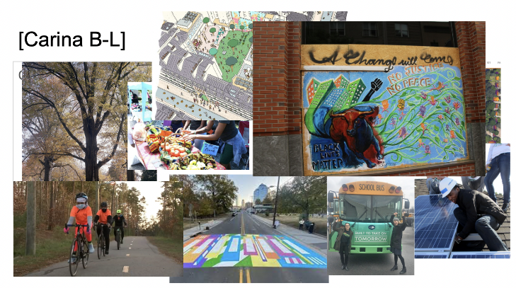
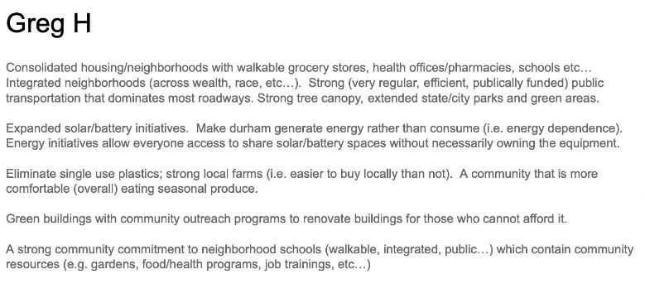
🛠 Tool for you to use with vols: (Virtual) Gallery walk

Slide 10
Tool: Community Power Mapping
Who is most impacted by the issue?
Who will it take to win– and sustain the win?
Where and with which constituencies does your coalition already have relationships?
Where do you need to invest resources and build relationships?
On the next slide, you will see an example of a community power map by a Green New Deal for Durham.

Slide 11
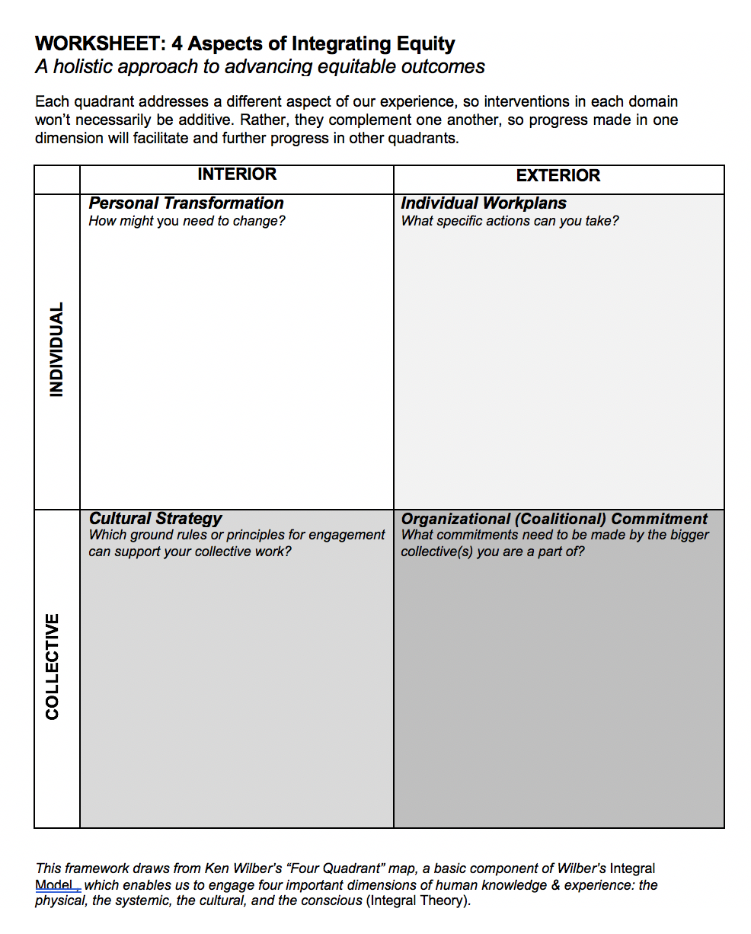
Worksheet pg. 12 4 Aspects of Integrating Equity

Slide 12
Part 3: Theory of Change and Strategy

Slide 13
Theory of Change
What is your theory of change?
Who is your target population?
What are the external trends?
What are the activities?
What are your short/long term outcomes?
What is your hypothesis/assumption?

Slide 14
Strategy
In the next slide, think about what is your leadership culture? How does this relate to your strategy and how will this be implemented in your organizational power?

Slide 15
AREA | VALUES BRAINSTORM | MOST STRATEGIC VALUES | PRACTICES BRAINSTORM
Leadership culture | Transparency Visionary Strategic Committed Walk the talk Transformative change | Walk the talk Strategic Ethical + transparent Visionary Committed to transformation (personal, organizational, movement) Doing it for the good of the movement | Commitment to transformation, ex: practice naming what you need support with like how you practice toxic culture Having meaningful time that is baked into the structural practices of the team,
Group / team culture | Joyful Accountable Takes Initiative Solution Oriented | -Joyful | Ex: Joyful, playing of music, cultural practice
Organizing culture | Committed to craft of organizing Healthy conflict re: strategy Centered on relational organizing Growth | Deep leadership development Never ending political education / access to political education Centered on relational organizing Growth | Deep coaching Identifying the needs of the team and intentionally seeking resources
Relational culture *how is relational culture different from group/team culture | 1) a desire to move into more relationships, because of how a good relational experience feels; 2) a sense of zest, or energy; 3) increased knowledge of oneself and the other person in the relationship; 4) a desire to take action both in the growth-fostering relationship and outside of it; 5) an overall increased sense of worth | A desire to take action both in the growth-fostering | Checks ins /calls for support Practice of appreciations Creating space for team building Support for individual growth that's offered through the team Climate Reparations Monthly happy hour, time on a Friday to just chat and check in
Identity & equity Add into equity filter | Accessibility for folks who hold different identities Decision making process- most impacted make decisions | Accessibility for folks who hold different identities | -holding space for cross movement organizing -staying away from jargon -breaking down concepts about climate and bringing everyone to the same page
Momentum Organizing 2021
Notes:
Culture isn’t just about the vibe or just resonating. It spans many areas - we’ve simplified them to the following 5:
Leadership culture - how your movement relates to leadership
Group or team culture - usually at the organization or staff level or on working teams
Movement / organizing culture - how you relate to organizing, the culture of your base, and how your movement is perceived by the public
Relational culture - level of vulnerability and self-reflection
Identity & equity - how your movement navigates race, class, gender, and other forms of oppression

Slide 16
Part 4: Scaling and Coalitions

Slide 17
Scaling and Coalitions
Can you use trigger events to build power and absorb new people into your organization? How can you use coalitions to build your organizational power?

